Slide 1
Working with Large Datasets in R
Columbia University Libraries Data Club Fall 2025
2025/10/09
Please access code here:
https://columbia-data.club/3pqedb
Wei Yin | wy2288@columbia.edu
Research Support & Data Services Librarian
Research Data Services | data@library.columbia.edu
Columbia University Libraries

Slide 2
outline
Please access slides using this tinyurl:
https://columbia-data.club/kcjbes
Please download OpenFEMA
NFIRS datasets 2024
Moacir created a short download link for the NFIRS 2024, so you can use either the original link above or the link below for download
https://columbia-data.club/lb8h6d
1. Large datasets in R setting
2. A few (possible) solutions
3. A few R packages

Slide 3
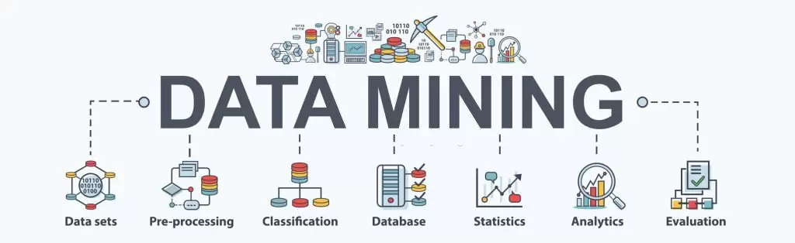
In R and RStudio, "large data" typically refers to datasets that exceed the available RAM (random access memory) of the computer running R.
A general rule of thumb suggests needing 2-3 times the RAM of your data size for comfortable processing.
Data exceeding 50% of available RAM are essentially unusable.
We consider a data set large if it exceeds 20% of the RAM on a given machine and massive if it exceeds 50%
1
Image source: dazonnassist

Slide 4

When I mention large datasets in today’s session, that means
Real world data - both in sciences and social sciences
Not perfectly simulated scientific data or well-maintained industry datasets/databases
Highly possible need data manipulation
Multiple data sources
Might use for customized research explorations
For stand alone individual machine users
What to do before using High Performance Computing (HPC) or cloud based research computing
Automation and iteration can be a different data club session
Image source: easy.peasy.ai

Slide 5

A few (possible) solutions on an individual’s laptop or desktop
There are no one-fits-for-all solutions
If you are reading my slides later, solutions can be totally different from today (Oct. 9, 2025), due to hardware and software improvements
2
Image source: aqua cloud

Slide 6

Two real world data examples
Seattle Public Library Checkouts Open Data
OpenFEMA guide to working with large datasets
Download only what you need.
To refresh data, attempt to perform updates rather than a full re-download.
Pre-process (filter and aggregate) prior to analysis using more standard tools.
Use tools more appropriate for working with large amounts of data—including programming languages.
Seek additional resources from the web regarding data science, data wrangling, and data analysis tools used to work with large amounts of data.
Data subsetting
Data partitioning
Various data formats are provided

Slide 7
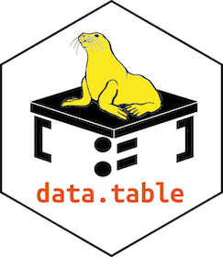





I will discuss a few R packages (version number > 1.0.0)
You might (or must) have other options
Moacir’s Python session on Oct. 23 will cover more details about Polars, so I won’t spend too much time today to talk about it.
3

Slide 8
Comparisons
dbplyr
vs.
dtplyr
1
data.table
2
arrow
3
4
duckplyr
5
polars
fread()
Ideal for medium size CSV files within memory
Not ideal for directly handling JSON and parquet files
Can also consider use vroom package and compare benchmarks
read_delim_arrow()
write_parquet()
Ideal for most of txt files including CSVs
data size can be larger than memory
dbplyr is dplyr backend packages (syntax compatibility)
dbplyr is based on SQL, so if you don’t know SQL, there is a learning curve
dtplyr is data.table backend and slower than data.table
Ideal for common data formats such as json, delimited files and parquet files
can handle large data sets that do not fit into RAM
full dplyr compatibility
The R packages now are not matured enough in my opinion
If you prefer to use polars, use Python for now (Oct. 2025) rather than R

Slide 9

Hands-on demo in R/Rstudio
Using OpenFEMA NFIRS datasets 2024

Slide 10

Thank you!
&
Ask us anything!
Columbia University Libraries Data Club Fall 2025
2025/10/09
Please find other data club sessions’ info here
Any questions related to today’s session please contact
Wei Yin
wy2288@columbia.edu
or
Research Data Services data@library.columbia.edu

